Slide 1
AgroPal
BCA 4th Sem Project Defence
Group A
Kathmandu Bernhardt College

Slide 2
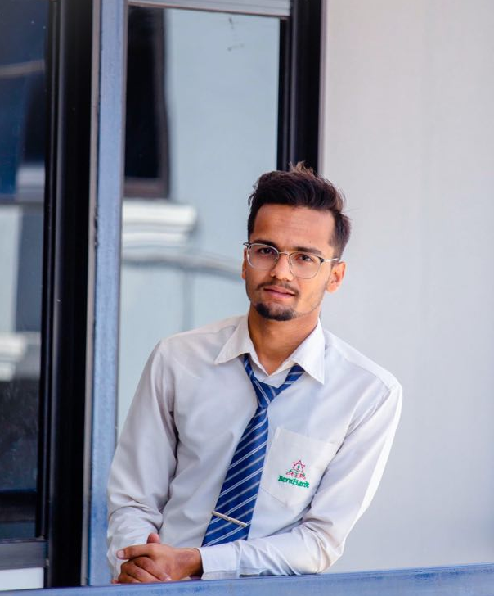
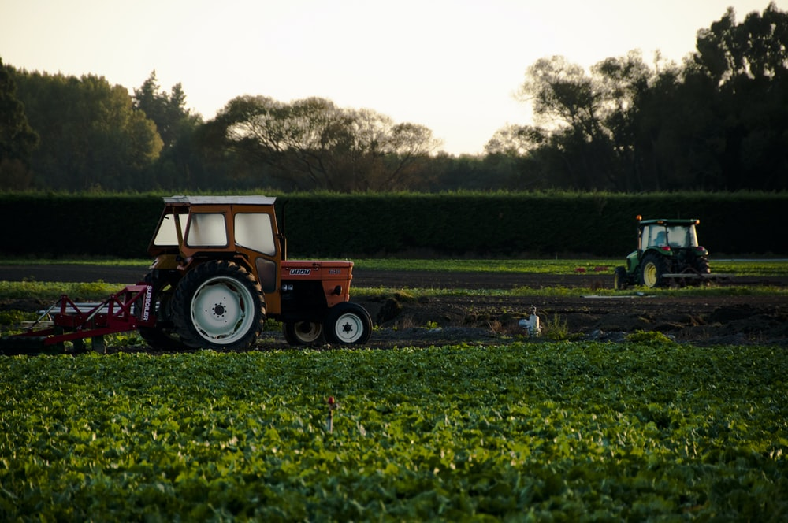
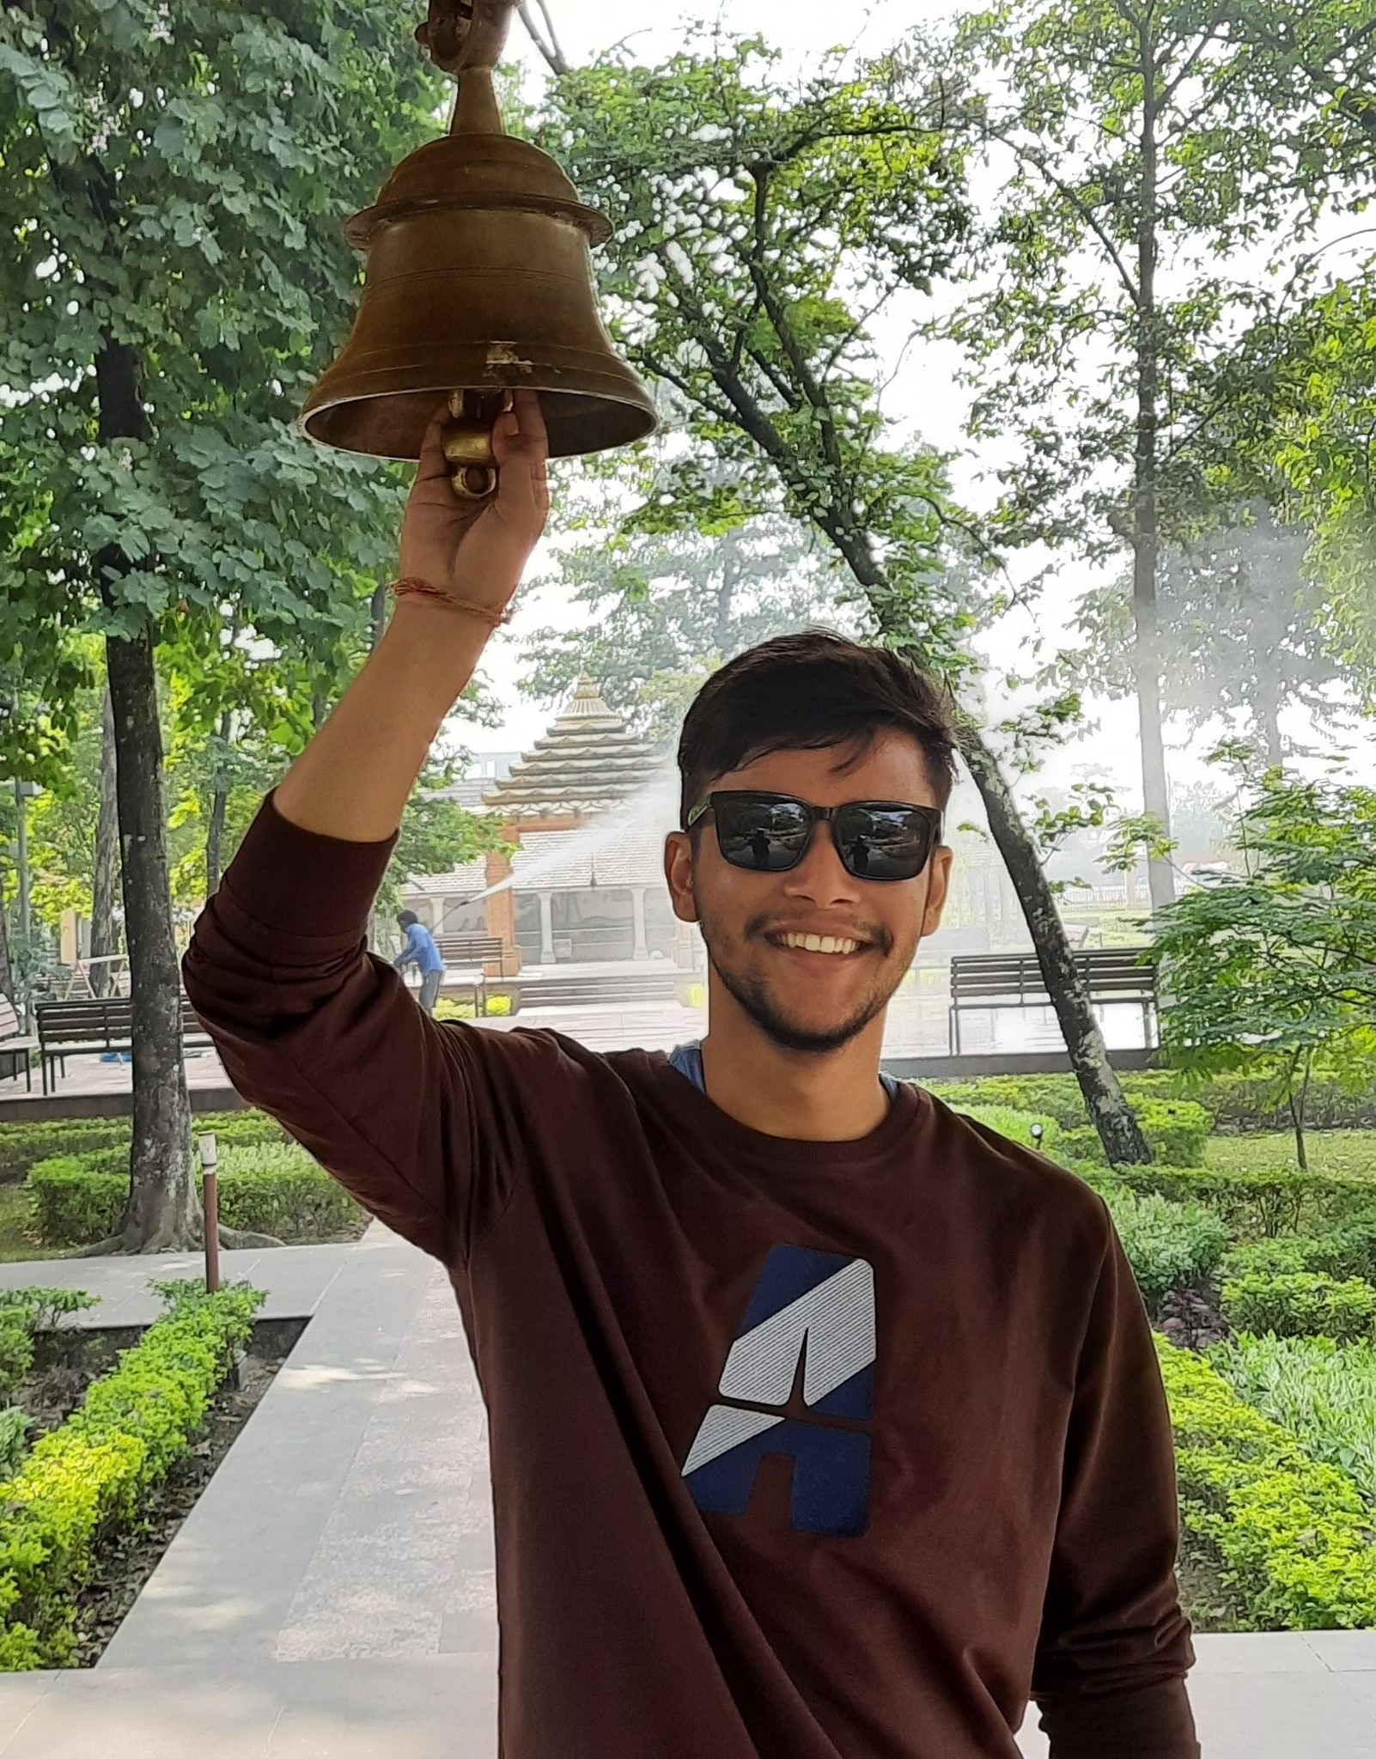
Aman Bhandari Nischal Adhikari
4610566 4610567
Meet our team.

Slide 3

INTRODUCTION
AgroPal is the combination of two words where ‘Agro’ stands for agriculture and ‘Pal’ is a Nepali word i.e. roof where AgroPal combine means all agricultural products under the same roof.
An online agriculture platform.
It helps farmers, sellers, and buyers to interact with each other.
The one who works hard (i.e. farmers) should be paid rather than 3rd parties.
It also deals with tools and equipment needed to farm at a lower price than others.

Slide 4
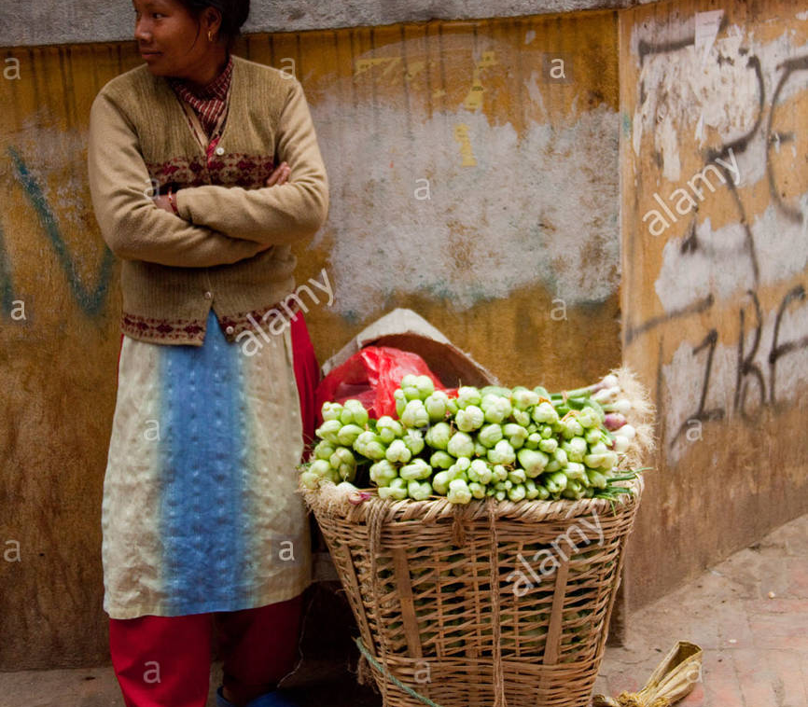
PROBLEM STATEMENT
People are not able to get organic food although there exists many local farmers who provide organic food.
There is lack of promoting local marketing for the organic products.
Farmers are not getting the agricultural tools and equipment which they can find on AgroPal.

Slide 5
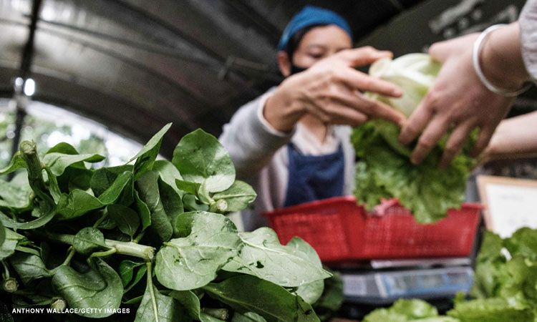
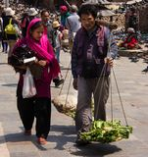
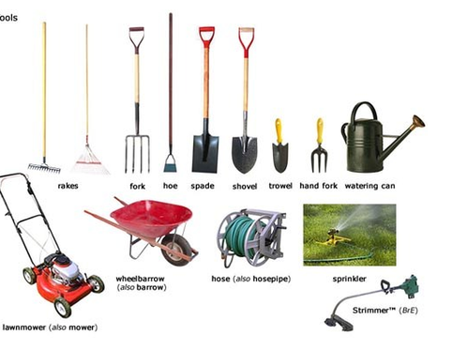
OBJECTIVES
Some of the major objectives of the system can be summarized as :
To provide organic products.
To develop direct relation between sellers and buyers.
To provide easy access of agricultural equipment and products.

Slide 6
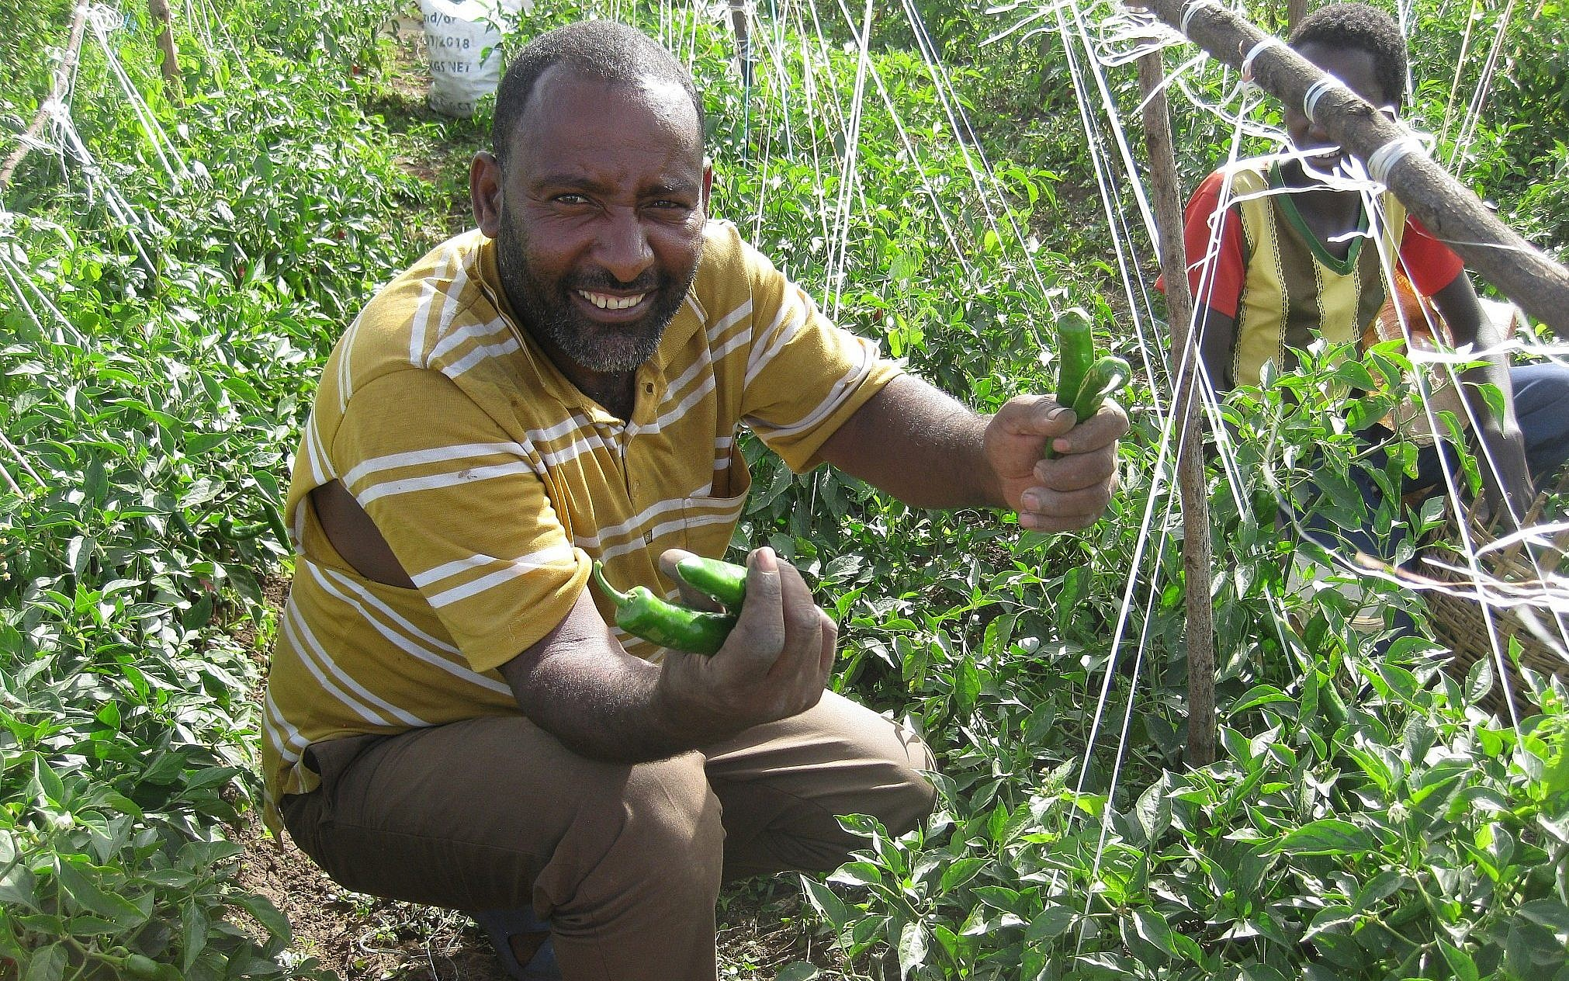

SCOPE & LIMITATIONS
Some of the scope and limitations of the system are given below:
Scope
Limitations
It contribute to promote local marketing of agriculture related field.
It doesn’t have access to digital payment.

Slide 7

Background study
BACKGROUND STUDY & LITERATURE REVIEW
For this project an online agricultural platform was choosen.
In the previous year 2020, as most of the people were quarantine so they begin to prefer online platform rather than visiting every day store so by viewing the situation here is ‘AgroPal’.
Web app is to inbuilt local marketing so that there is no waste of degradable products and helps to reduce imports of it from foreign countries.

Slide 8
Literature review
The research and reviews for the project are some of the related websites of our country.
AgroMart is in practice to sell organic products and herbs/shrubs to cultivate.
It provides necessary platform for farmers to sell their products but does not provide the necessary tools.
AgriNepal is providing compost fertilizers, seeds, and agricultural tools.
It is a great web page which provides farmers with necessary tools and seeds but does not provide farmers the necessary platform and exposer to sell their products.
So to counter the above limitations this project was made.

Slide 9

System Analysis.
SYSTEM ANALYSIS & DESIGN
It is divided into four parts
Requirement Analysis (functional & non-functional)
Feasibility study (technical, Econmical, Schedule)
Data Modeling (ER diagram)
Process Modelling (DFD)

Slide 10
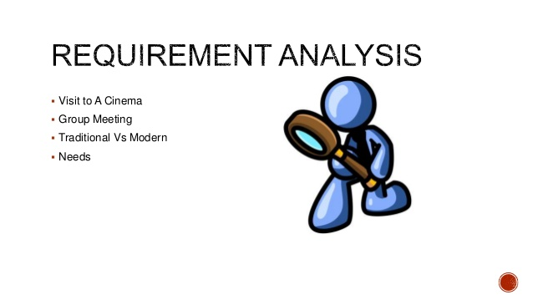
Requirement Analysis.
SYSTEM ANALYSIS & DESIGN
Requirement analysis is tasks that go to the needs or conditions to meet for a new project.
Visit E-commerce website.
Group meeting.
Consult with agricultural students.
Gathering needs
Types of requirement analysis
Functional requirement
Non-functional requirement

Slide 11
Functional Analysis.
SYSTEM ANALYSIS & DESIGN
Register: Enter or record on the site for the first time, once registered user needs only email & password.
Login: Logging in is the process by which an individual gains access to a web application by identifying and authenticating themselves.
Add, update and delete: Feature of adding product photos, description, price of the product & the quantity available.
Contact: The buyer can directly contact us through contact page by writing message.

Slide 12
Functional Analysis.
SYSTEM ANALYSIS & DESIGN
Add to cart: The buyer can add a product to cart and purchase a products in large quantity.
User management: Admin can check the user profile and manages the user.
Search: Anyone entering the web app can search the product and decide to purchase.

Slide 13
Non-Functional Analysis.
SYSTEM ANALYSIS & DESIGN
Usability: Efficiency to use because many task user can complete without any help. Simple to understand the interface.
Security: The admin can only view the number of users and the details of seller.

Slide 14
Feasibility Study.
SYSTEM ANALYSIS & DESIGN
Technical feasibility : The system is developed using existing development tools and technologies.
Economic feasibility: It is economically feasible because it is developed using open-source tools and no any paid softwares is used to build this project.
Schedule feasibility: The project is to be complete, realistic and achievable under a deadline according to strategy.

Slide 15
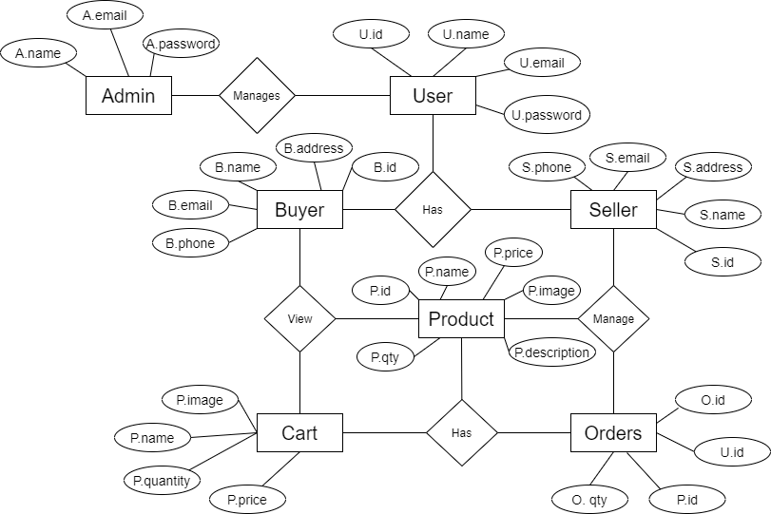
System analysis & design
Users Entity: Attributes of Users are user_id, user_name. user_mobile. user_email, user_usemame, user_password. user_address.
Admin Entity: Attributes of Admin are admin_id, admin_email, admin_password.
Products Entity: Attributes of Products are product_id. product_name. product_description, product_price, product_image.

Slide 16
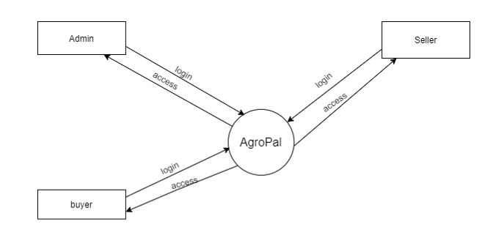
System analysis & design
DFD Level 0 of Agropal contains basic relationship of users (Buyer, Seller) and admin.

Slide 17
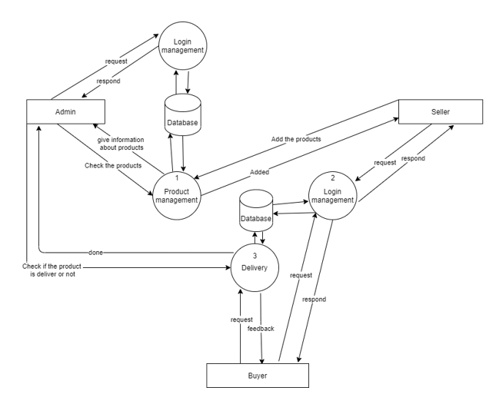
System analysis & design
DFD Level 1 then goes one step deeper into parts of Level 0 of Agropal.
It is designed to be an at-a-glance view of the products and showing the system as a single high-level process, with its relationship to external entities of users and their posts.

Slide 18
System Design
SYSTEM ANALYSIS & DESIGN
It is divided into two parts:-
Database Schema
Interface design

Slide 19
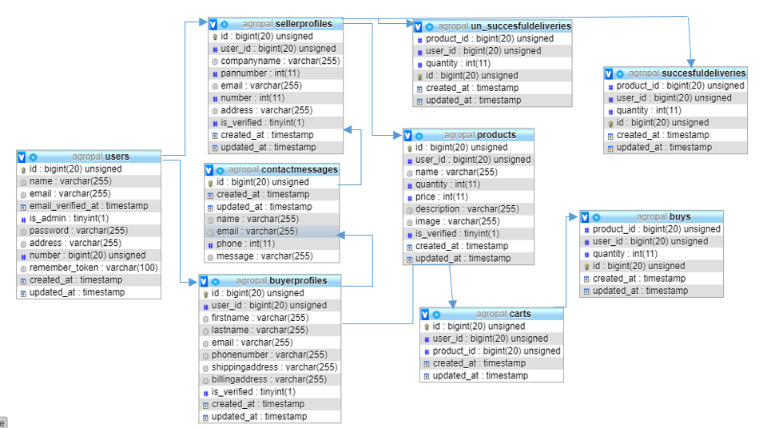
Database Schema
SYSTEM ANALYSIS & DESIGN
It is the skeleton structure that represents the logical view of the entire database
Defines how the data is organized and how the relations among them are associated
It formulates all the constraints that are to be applied on the data.

Slide 20
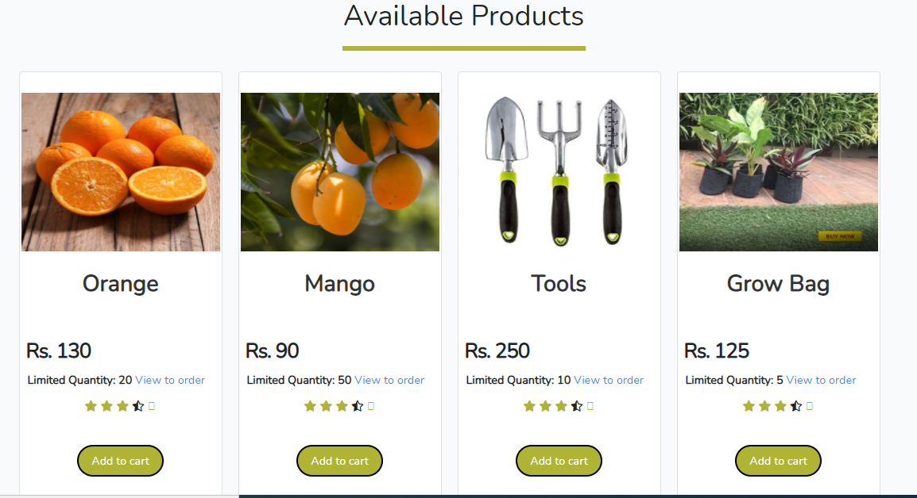
Interface Design
SYSTEM ANALYSIS & DESIGN
This is the interface design of the home page.

Slide 21
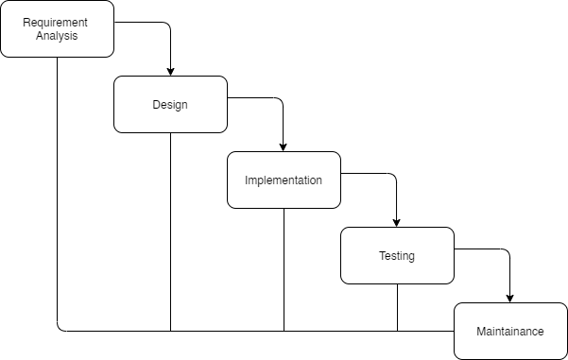
Implementation
implementation and testinG
The sequential phases in Waterfall model are:
Requirement Analysis
Design
Implementation
Testing
Maintainance

Slide 22
Tools Used (CASE Tools, Programming languages, Database platforms)
implementation and testinG
The different types of CASE tools used in the project are:
Diagram Tools
Configuration Tools
Web development tools

Slide 23
Tools Used (CASE Tools, Programming languages, Database platforms)
implementation and testinG
Case tools used in project
Diagram Tools
The components of the system, and the flow of the data and control between these components are demonstrated by diagram tools by using graphs. “Draw.io” and “Creately” are the diagram tool used in the project.

Slide 24
Tools Used (CASE Tools, Programming languages, Database platforms)
implementation and testinG
Case tools used in project
Configuration Tools
An instance of software is released under one version. CASE tools help in this by automatic tracking, version management and release management. Git is used as configuration management tool.

Slide 25
Tools Used (CASE Tools, Programming languages, Database platforms)
implementation and testinG
Case tools used in project
Web development tools
These tools assist in designing web pages with all allied elements like forms, text, script, graphic and so on. Visual Studio Code, Sublime Text Editor, GitHub are used as web development tools in the project.

Slide 26
Tools Used (CASE Tools, Programming languages, Database platforms)
implementation and testinG
The different frontend tools used in project:
HTML 5 (Hyper Text Mark-up Language)
CSS 3 (Cascading Style Sheet)
JavaScript
Bootstrap

Slide 27
Tools Used (CASE Tools, Programming languages, Database platforms)
implementation and testinG
Fontend tools used in project
HTML 5 (Hyper Text Mark-up Language)
HTML is the set of markup symbols or codes inserted into a file intended for display on the Internet. The markup tells web browsers how to display a web page's words and images.

Slide 28
Tools Used (CASE Tools, Programming languages, Database platforms)
implementation and testinG
Fontend tools used in project
CSS 3 (Cascading Style Sheet)
CSS is a style sheet language used for describing the presentation of a document written in a markup language such as HTML. CSS is a cornerstone technology of the World Wide Web, alongside HTML and JavaScript.

Slide 29
Tools Used (CASE Tools, Programming languages, Database platforms)
implementation and testinG
Fontend tools used in project
JavaScript
It is high-level, often just-in-time compiled, and multi-paradigm. It has curly-bracket syntax, dynamic typing, prototype-based object-orientation, and first-class functions.

Slide 30
Tools Used (CASE Tools, Programming languages, Database platforms)
implementation and testinG
Fontend tools used in project
Bootstrap
It open-source CSS framework directed at responsive, mobile-first front-end web development. It contains CSS- and JavaScript-based design templates for typography, forms, buttons, navigation, and other interface components.

Slide 31
Tools Used (CASE Tools, Programming languages, Database platforms)
implementation and testinG
The different backend tools used in project:
Laravel 8
Php MySQL 8.0
Xampp Server 3.2.4

Slide 32
Tools Used (CASE Tools, Programming languages, Database platforms)
implementation and testinG
Backend tools used in project
Laravel 8
It is used with expressive, elegant syntax. It is selected and used as the php framework in project. It eases common tasks used in the majority of web projects, such as authentication, routing, sessions, and caching.

Slide 33
Tools Used (CASE Tools, Programming languages, Database platforms)
implementation and testinG
Backend tools used in project
Php MySQL 8.0
It is used to create database to store information regarding all the posts, users, likes, comments, messages. It is used for syncing information from local host to server using xampp as server.

Slide 34
Tools Used (CASE Tools, Programming languages, Database platforms)
implementation and testinG
Backend tools used in project
Xampp Server 3.2.4
The user uses it to create local server in his machine to check stability of application and response of server during live hours.

Slide 35
Implementation details of modules (Description of procedures)
implementation and testinG
Product Module: This module is used to add/update/delete a product from the platform. It helps to display the product on the platform.
Cart Module: Used for adding the products to the cart of user. By adding the product in cart only a buyer can purchase a product.
Message Module: This module is used for managing the contact message which is received by the admin.

Slide 36
Implementation details of modules (Description of procedures)
implementation and testinG
Users Module: This module is used for managing the users of the website. It is responsible for buying and selling by updating details.
Buyer/Seller Module: This module helps to manage the information and store the information of buyers and sellers.

Slide 37
Test cases for unit testing
implementation and testinG
Testing
Test case | Scenario | Enter Value | Expected output | Actual output | Remarks
1 | Launch without opening xampp server. | Enter php artisan serve in terminal. | Link redirect to webpage | Error because of not opening server. | FAIL
2 | Launch with opening xampp | Enter php artisan serve in terminal. | Link redirect to webpage, | Launch successful, redirect to home page | PASS
AgroPal Launch a webpage.

Slide 38
Test cases for unit testing
implementation and testinG
Testing
Test casea | Scenario | Enter Value | Expected output | Actual output | Remarks
1 | Register without filling any fields. | Null | All fields are required. | Please fill the form. | FAIL
2 | Register with correct details. | Name: Aman Bhandari Email: amanbhandari188@gmail.com Password: 123456789 Confirm password: 123456789 Number: 9861436723 Address: kathmandu | Register successful and go to home screen. | Register Successful. | PASS
3 | Enter already registered details. | Name: Aman Bhandari Email: amanbhandari188@gmail.com Password: 123456789 Confirm password: 123456789 Number: 9861436723 Address: kathmandu | Register unsuccessful | Email has already been taken. | FAIL
4 | Enter invalid data | Name: Aman Bhandari Email: amanbhandari Password: 123456 Confirm password: 123456789 Number: 986143 Address: kathmandu | Register unsuccessful | Number must be 10 digits. Email must be valid. Password doesn’t match. | FAIL
AgroPal User Registration.

Slide 39
Test cases for unit testing
implementation and testinG
Testing
Test case | Scenario | Enter Value | Expected output | Actual output | Remarks
1 | Login with correct email and paddword. | Email: amanbhandari188@gmail.com Password: 123456789 | Go to home page. | Login successful | PASS
2 | Login with wrong password | Email: amanbhandari188@gmail.com Password: 123456 | Login unsuccessful | These credentials do not match our records. | FAIL
3 | Login with wrong email | Email: amanbhandari Password: 123456789 | Login unsuccessful | These credentials do not match our records. | FAIL
AgroPal User Login.

Slide 40
Test cases for unit testing
implementation and testinG
Testing
Test case | Scenario | Enter Value | Expected output | Actual output | Remarks
1 | Add to cart without login | Add to cart | Redirect to login page. | Redirect to login page | FAIL
2 | Add to cart by login | Email: amanbhandari188@gmail.com Password: 123456789 | Successfully added and redirect to cart page. | Added successfully | PASS
AgroPal Cart.

Slide 41
Test cases for unit testing
implementation and testinG
Testing
Test case | Scenario | Enter Value | Expected output | Actual output | Remarks
1 | Registered seller try to add product. | Add a product | You are not verified. | Redirect to home page | FAIL
2 | Registered and verified seller. | Add a product | Redirect to add a product page. | Added successfully | PASS
3 | Not registered seller | Add a product | Register as seller. | Redirect to home page | FAIL
AgroPal Seller Add a product.

Slide 42
Test cases for system testing
implementation and testinG
AgroPal Seller Add a product.
Testing
Test case | Scenario | Enter Value | Expected output | Actual output | Remarks
1 | Launch with opening xampp | Enter php artisan serve in terminal. | Link redirect to webpage, | Launch successful, redirect to home page | PASS
2 | Register with correct details. | Name: Aman Bhandari Email: amanbhandari188@gmail.com Password: 123456789 Confirm password: 123456789 Number: 9861436723 Address: kathmandu | Register successful and go to home screen. | Register Successful. | PASS
3 | Registered as seller. | Company name: Tarkari Pasal Email: pasal@gmail.com Pan number: 234567891 Phone number: 1234567890 Address: Kathmandu. | Register successful. | Redirect to home page. | PASS
4 | If not verified by admin. | Add a product | Not verified by admin. | Redirect to home page | FAIL
5 | If verified by admin. | Add a product/ view product/edit a product. | Successful | Succesful. | PASS
6 | Search a product with valid name | Mango | Product found | Here is the product. | PASS
7 | Search a product with invalid name | Aap | Product not found. | The product is not available | Fail
8 | Add to cart by login in. | Add to cart. | Successfully added and redirect to cart page. | Added successfully | PASS
9 | Buy now | Buy now | Successful | Redirect to home page | PASS

Slide 43
Test cases for system testing
implementation and testinG
Testing
Test case | Scenario | Enter Value | Expected output | Actual output | Remarks
1 | Launch with opening xampp | Enter php artisan serve in terminal. | Link redirect to webpage, | Launch successful, redirect to home page | PASS
2 | Login as admin | Email: admin@gmail.com Password: 123456789 | Login successful and go to home screen. | Login Successful. | PASS
3 | Dashboard/ register seller | Verify | Register seller can only add a product. | Successful | PASS
4 | Dashboard/ Product details | View and verify | Verified products only can be displayed. | Successful | PASS
5 | Dashboard/ Orders | Make successful/unsuccessful | If successful then it will be delivered | Succesful. | PASS
6 | Dashboard/ Contact message. | Read message | Read | Successful | PASS
AgroPal Admin interface.

Slide 44
CONCLUSION AND FUTURE RECOMMENDATION
Lesson learnt / outcomes
There have been several improvements in our programming language and writing skills as well as our time management skills while doing this project. It was difficult at the beginning because it was our first project and everything was new. Although it is our first project it turned out to match all the expectations. A lot was learned about proper time management as the project had to be submitted before the deadline along with the documentation.
Although it is expectedly good, some new features to this system could be added in the upcoming days to make it more user friendly and efficient.

Slide 45
CONCLUSION AND FUTURE RECOMMENDATION
Conclusion
With the completion of the project, it has been able to boost academic knowledge and bring it to real practice. The experience of working in a team and maintaining cooperative behaviour has been got. The use and implementation of web-based application has been learnt by the project. Throughout the period, all technical and non-technical stuffs have been learnt in a healthy environment.
The project is done by using php framework Laravel and HTML CSS (bootstrap) in Visual Studio Code. It shows all the information regarding the products added. This application is made to simplify the living style of people making them easy to get organic products. The main objective of this application is to build a web-based application for people to get proper and healthy products as well as to for farmers to get proper amount for their products.
Thus, working in a group for the project, also a novice in field of web application programming with very minor knowledge was a challenging task but was very much worthwhile to learn and experience.

Slide 46
CONCLUSION AND FUTURE RECOMMENDATION
Future recommendations
The applicability and usage of this project can be increased by enhancing the system based on the limitations. This helps to uplift the productivity of the system. Features like a digital payment can be added that can help in limited usability of paper money. Also, Order tracker may be used which makes buyers easy to know where is his/her order.
Also, more capabilities can be delivered in the future to increase the competency and productivity of the team.

Slide 47
VIDEO SLIDE

Slide 48
THANK YOU!
Team AgroPal
Any Queries where we can assist you?
Aman Bhandari
Nischal Adhikari

